Slide 1
Grawitajca w handlu
Dr Łukasz Matuszczak

Slide 2
Grawitajca w handlu
Evolution of gravity theory over time (Y. V. Yotov 2016)
Notes:
https://oxfordre.com/economics/view/10.1093/acrefore/9780190625979.001.0001/acrefore-9780190625979-e-327
https://www.wto.org/english/res_e/booksp_e/advancedwtounctad2016_e.pdf

Slide 3
Grawitajca w handlu
Review of the structural gravity model
The domestic production: Yi=piQi
The domestic expenditure: Ei=øiYi,
Where øi>1 shows that country i runs a trade deficit
If 1> øi>0, reflects a trade surplus
On the demand side, consumer preferences are assumed to be homothetic, identical across countries, and given by a CES-utility function for country j:
${(\sum_{i}{α_{i}^{\frac{1−σ}{σ}}c_{ij}^{\frac{σ−1}{σ}}})}^{\frac{σ}{σ−1}}$, where
σ > 1 is the elasticity of substitution among different varieties
αi > 0 is the CES preference parameter, which will remain treated as an exogenous taste parameter
cij denotes consumption of varieties from country i in country j
Notes:
Homogeniczny stopnia k f(sv)=s^(k) f({v})}
Homotetyczny – homogeniczny stopnia 1

Slide 4
Grawitajca w handlu
The consumer maximize above utiulity with respect to budget constraint: $\sum_{i}{p_{ij}c_{ij}=E_{j}}$
$E_{j}$ - total spending on varieties from all countries, including j
prices pij = pitij , function of factory-gate prices in the country of origin, pi marked up by bilateral trade costs, tij ≥ 1, between trading partners i and j –”iceberg costs” (Anderson, 2011)
Notes:
Homogeniczny stopnia k f(sv)=s^(k) f({v})}
Homotetyczny – homogeniczny stopnia 1

Slide 5
Grawitajca w handlu
Consumer solution: the expenditures on goods shipped from origin i to destination j as:
$$X_{ij}={\left(\frac{α_{i}p_{i}t_{ij}}{P_{j}}\right)}^{(1−σ)}E_{j}$$
Xij denotes trade flows from exporter i to destination j
Pi can be interpreted as a CES consumer price index:
$P_{i}={\left[\sum_{i}{{\left(α_{i}p_{i}t_{ij}\right)}^{1−σ}}\right]}^{\frac{1}{1−σ}}$
[1]
[2]
Notes:
Homogeniczny stopnia k f(sv)=s^(k) f({v})}
Homotetyczny – homogeniczny stopnia 1

Slide 6
Grawitajca w handlu
Given that the elasticity of substitution is greater than one, σ >1, the expenditure Xij is:
proportional to total expenditure, Ej , in destination j
inversely related to the (delivered) prices of varieties from origin i to destination j, pij = pitij
directly related to the CES price aggregator Pj. This relationship reflects the substitution effects across varieties from different countries
contingent on the elasticity of substitution σi when factory-gate prices or the aggregate CES prices (or in the combination of those
Notes:
Homogeniczny stopnia k f(sv)=s^(k) f({v})}
Homotetyczny – homogeniczny stopnia 1
The simple intuition is that, all else equal, larger/richer markets consume more of all varieties, including goods from i.
This is a direct reflection of the law of demand, which depends not only on factory-gate price pi but also on bilateral trade cost t ij between partners i and j. The ideal combination that favours bilateral trade is an efficient producer, characterized by low factory-gate price, and low bilateral trade cost between countries i and j.
All else equal, the relatively more expensive the rest of the varieties in the world are, the more consumers in country j will substitute away from them and toward the goods from country i.
as a relative price) change. All else equal, a higher elasticity of substitution will magnify the trade diversion effects from the more expensive commodities to the cheaper ones.

Slide 7
Grawitajca w handlu
Market clearance for goods from each origin:
$$Y_{i}=\sum_{i}{{\left(\frac{α_{i}p_{i}t_{ij}}{P_{j}}\right)}^{(1−σ)}E_{j} } →Y_{i}\text{ ≡ }\sum_{j}{X_{ij}}\text{ ∀ }\text{j}\text{ .}$$
Defining Y$\text{≡ }\sum{Y_{i}}$and dividing equation (left-hand side) by Y:
$${\left(α_{i}p_{i}\right)}^{1−σ}=\frac{\frac{Y_{i}}{Y}}{\sum_{j}{{\left(\frac{t_{ij}}{P_{j}}\right)}^{1−σ}}\frac{E_{j}}{Y}}$$
Following Anderson and van Wincoop (2003) we can rewrite the denominator as:
$$Π_{i}^{1−σ}\text{≡}\sum_{j}{{\left(\frac{t_{ij}}{P_{j}}\right)}^{1−σ}}\frac{E_{j}}{Y} → { \left(α_{i}p_{i}\right)}^{1−σ}=\frac{\frac{Y_{i}}{Y}}{Π_{i}^{1−σ}}$$
[3]
[4]
[5]

Slide 8
Grawitajca w handlu
Podstawiając [5] do równania [1] oraz równania cenowego [2] oraz zestawiając z definicją $Π_{i}^{1−σ}$ otrzymujemy system strukturalnego modelu grawitacyjnego: $$X_{ij}={\frac{Y_{i}E_{j}}{Y}\left(\frac{t_{ij}}{{Π_{i}P}_{j}}\right)}^{(1−σ)}E_{j}$$
$${Π_{i}}^{1−σ}=\sum_{j}{{\left(\frac{t_{ij}}{P_{j}}\right)}^{(1−σ)}}\frac{E_{j}}{Y}$$
${P_{j}}^{1−σ}=\sum_{j}{{\left(\frac{t_{ij}}{Π_{j}}\right)}^{(1−σ)}}$ $\frac{Y_{i}}{Y}$
[A]
[B]
[C]

Slide 9
Grawitajca w handlu
Dekompozycja modelu strukturalnego ([A]) otrzymujemy:
Komponent rozmiaru $\frac{Y_{i}E_{j}}{Y}$
Komponent kosztu ${\left(\frac{t_{ij}}{{Π_{i}P}_{j}}\right)}^{(1−σ)}$
Notes:
expenditure share on goods from a particular country will be equal to the share of production in the source country in the global economy
Overall, the size term already carries some very useful information regarding the relationship between country size and bilateral trade flows:5 namely, large producers will export more to all destinations; big/rich markets will import more from all sources; and trade flows between countries i and j will be larger the more similar in size the trading partners are
e. The trade cost term consists of three components: (1) Bilateral trade cost between partners i and j, t ij , is typically approximated in the literature by various geographic and trade policy variables, such as bilateral distance, tariffs and the presence of regional trade agreements (RTAs) between partners i and j. (2) The structural term Pj , coined by Anderson and van Wincoop (2003) as inward multilateral resistance represents importer j’s ease of market access. (3) The structural term Πi , defined as outward multilateral resistances by Anderson and van Wincoop (2003), measures exporter i’s ease of market access

Slide 10
Grawitacja – przykłady empiryczne
Rozmiar a wielkość handlu
Źródło: Keith Head, Thierry Mayer. Gravity Equations: Workhorse, Toolkit, and Cookbook. 2013.

Slide 11
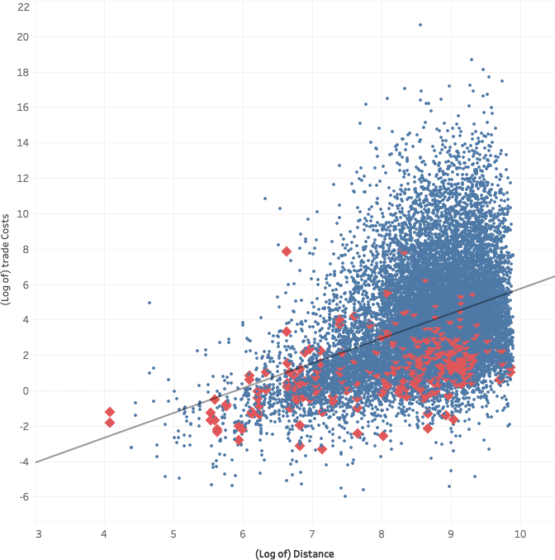
Grawitacja – przykłady empiryczne
Odległość a wielkość handlu
Trade costs and distance for countries with (♦) and without (●) a colonial relationship.
Źródło: https://oxfordre.com/economics/view/10.1093/acrefore/9780190625979.001.0001/acrefore-9780190625979-e-327#acrefore-9780190625979-e-327-div1-1

Slide 12
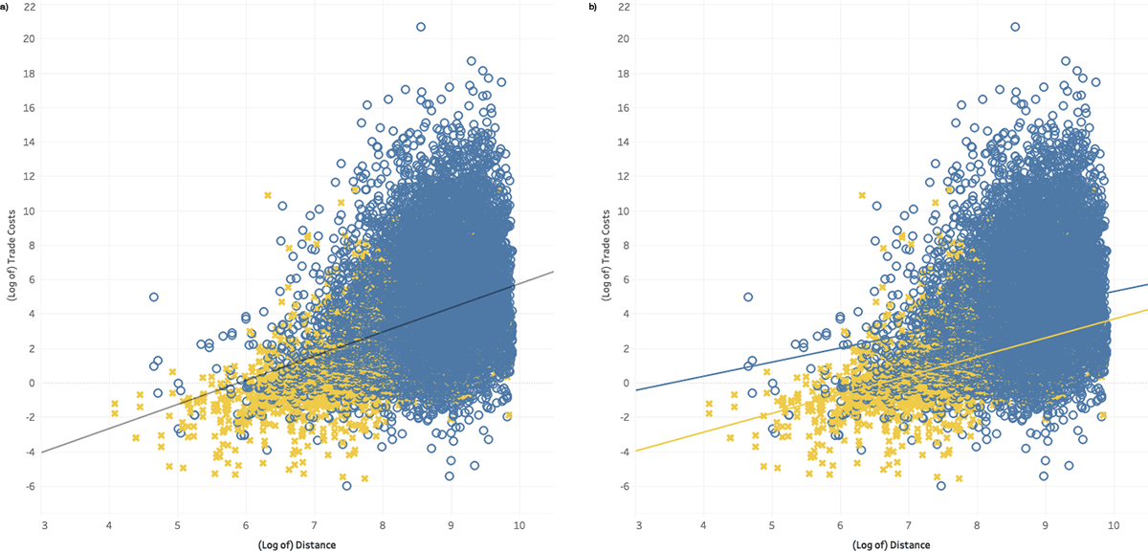
Grawitacja – przykłady empiryczne
RTA a wielkość handlu
Distance and trade costs for countries with (x) and without (●) a free trade agreement. (a). combined fitted line. (b). separate fitted lines
Źródło: https://oxfordre.com/economics/view/10.1093/acrefore/9780190625979.001.0001/acrefore-9780190625979-e-327#acrefore-9780190625979-e-327-div1-1

Slide 13
Estymacja modeli grawitacyjnych.
Ze względu na multiplikatywną formę modelu [A] logarytmujemy:
${lnX}_{ij,t}={lnE}_{j,t}$+ ${lnY}_{i,t}−$ ${lnY}_{t}$ $+{\left(1−σ\right)lnt}_{ij,t}$ - $\left(1−σ\right){lnP}_{j,t}−\left(1−σ\right){lnΠ}_{i,t}+$ $ε_{ij,t}$
When panel data are not available, the gravity model can still be estimated with cross-section samples:
${lnX}_{ij}={lnE}_{j}$+ ${lnY}_{i}−$ ${lnY}_{}$ $+{\left(1−σ\right)lnt}_{ij}$ - $\left(1−σ\right){lnP}_{j}−\left(1−σ\right){lnΠ}_{i}+$ $ε_{ij}$
In accordance with gravity theory, directional time-varying (importer and exporter) fixed effects should be included in panel trade data.
Pair fixed effects should be included in gravity estimation with panel trade data.

Slide 14
Estymacja modeli grawitacyjnych.
OLS estimation controlling for multilateral resistance terms with fixed effects
$${lnX}_{ij,t }=Π_{i,t}+Χ_{j, t}+β_{1}{\ln{DIST}}_{ij}+β_{2}{\ln{CNTG}}_{ij}{+β}_{3}{\ln{LANG}}_{ij}+{β_{4}ln{CLNY}}_{ij}+ε_{ij,t},$$
$Π_{i,t}$ – wektor exporter-time fixed effects,uwzględniające zewnętrzne multilateral resistances terms
$Χ_{j, t}$ – wektor importer-time fixed effects,uwzględniające wewnętrzne multilateral resistances terms
DIST – dystans bilateralny
CNTG –wspólna ciągła granica między i and j
LANG – zmienna 0-1 wspólny język
CLNY – zmienna 0-1 wspólna przeszłość kolonialna.
Notes:
No constant term is included in the presence of the fixed effects. By definition, both exporter-time and importer-time fixed effects will absorb, respectively, the exporter value of output and importer expenditure, as well as all other observable and unobservable exporter- and importer-specific characteristics that may influence bilateral trade

Slide 15
Estymacja modeli grawitacyjnych.
OLS estimation controlling for multilateral resistance terms with remoteness indexes
$${lnX}_{ij,t }=β_{0}+β_{1}{\ln{DIST}}_{ij}+β_{2}{\ln{CNTG}}_{ij}{+β}_{3}{\ln{LANG}}_{ij}{+β}_{4}{\ln{CLNY}}_{ij}+$$
$$+{β_{5}{lnY}_{i,t}+β}_{6}{lnE}_{j,t}+{β_{7}{lnREM_EXP}_{i,t}+β}_{8}{{lnREM_IMP}_{j,t}+ε}_{ij,t}$$
${lnREM_EXP}_{it} ; {lnREM_IMP}_{it}$– remotenes index (Head, 2003)
${lnREM_EXP}_{i,t}=\ln\left({\sum_{j}{{DIST}_{ij}}}/{\frac{E_{j,t}}{Y_{t}}}\right)$;
$${lnREM_IMP}_{i,t}=\ln\left({\sum_{j}{{DIST}_{ij}}}/{\frac{Y_{i,t}}{Y_{t}}}\right)$$
$Y_{i,t}$ – exporter output
$E_{j,t}$ – importer expenditure
Notes:
No constant term is included in the presence of the fixed effects. By definition, both exporter-time and importer-time fixed effects will absorb, respectively, the exporter value of output and importer expenditure, as well as all other observable and unobservable exporter- and importer-specific characteristics that may influence bilateral trade

